Slide 1
For Live Session Assignment (FLS)
Unit 3

Slide 2
Question 1: Quick Quiz Questions

Slide 3
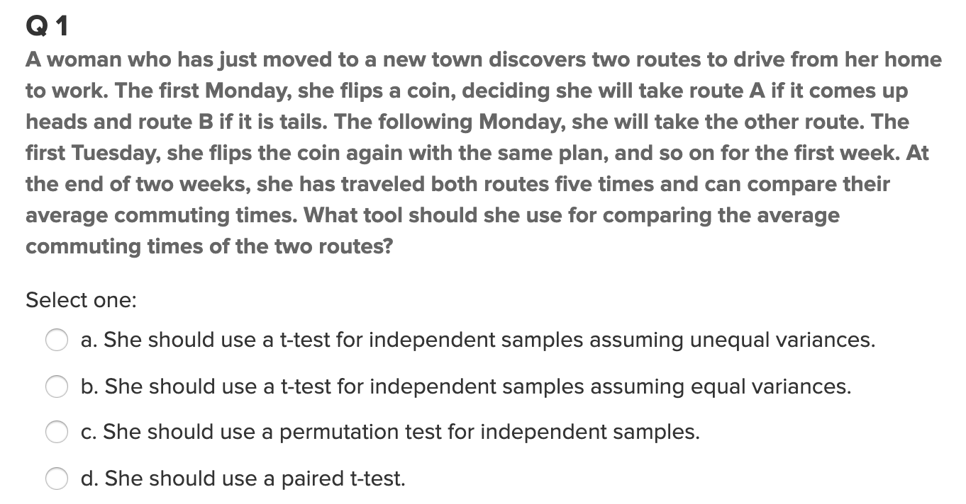
Question 1

Slide 4
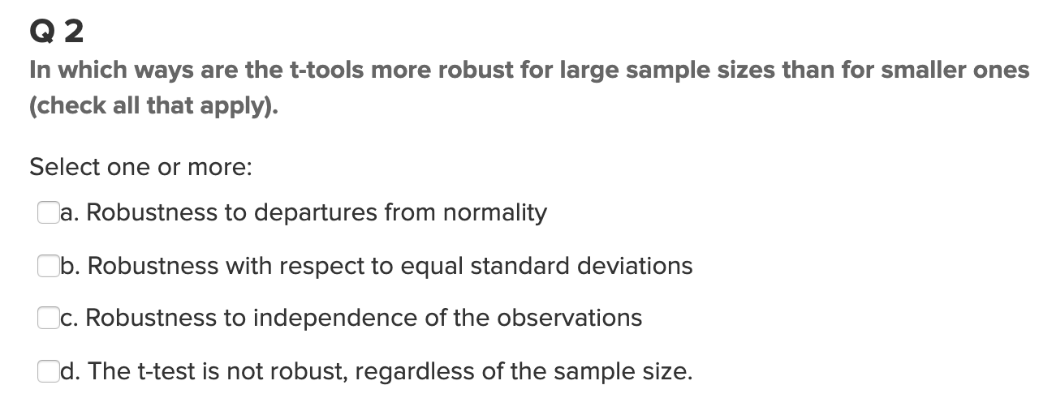
Question 2

Slide 5
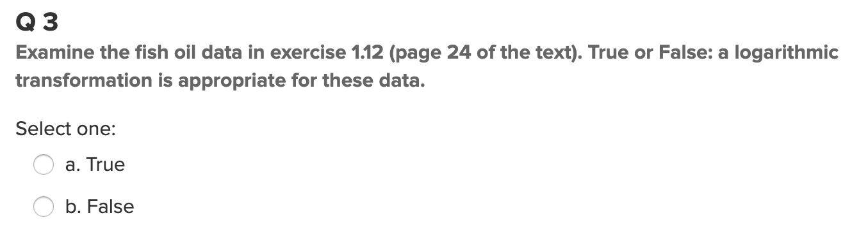
Question 3

Slide 6
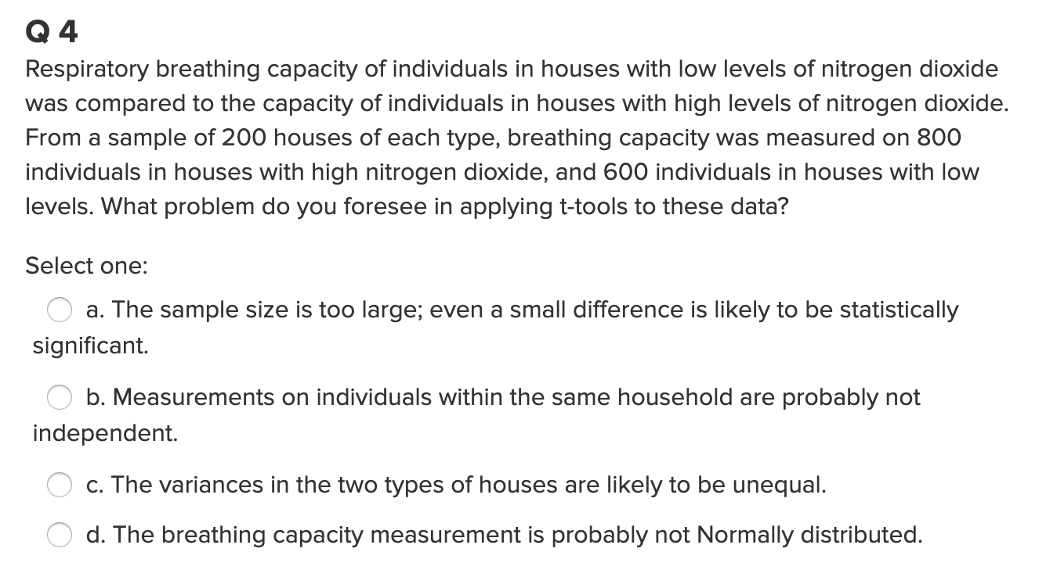
Question 4

Slide 7
End Question 1: Quick Quiz Questions

Slide 8

Question 2 ($≤2$ hours)

Slide 9
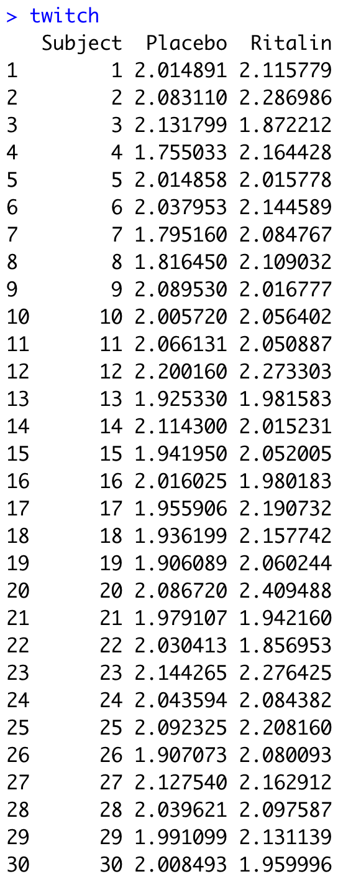
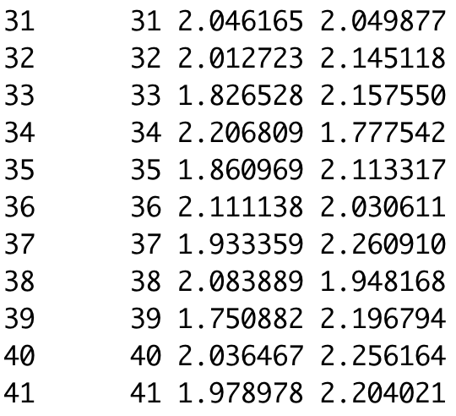
Reaction Time Experiment
A double blind study was conducted to test the effect of the drug Ritalin on the reflexes. To test for this effect, subjects were recruited via an add in the newspaper and paid $500 for their time. The subject was to come in twice and would be given a placebo in one of the visits and a dose of Ritalin in the other visit. Neither the subjects nor the researcher that gave the subject the pills new which was the Ritalin and which was the placebo (double blind). During both visits the subject wore earphones and had twitch detectors taped to the skin around their eyes. The headphones would play a soft static sound and would periodically blast a loud sound that would cause the subject to twitch. The researchers had a machine that would measure and record the time between the sound being initiated and the subjects eye twitch. For each subject the sound was initiated 10 times and the average reaction time was recorded.
The data file twitch.csv contains the average reaction time while on the placebo and Ritalin treatments.
Your goal is to conduct the appropriate 6 – step test to see if there is evidence that Ritalin causes slower reaction time.
Hint for this problem: Be mindful of your choice of test!
Be sure to include a confidence interval and mention if it agrees with the hypothesis test.

Slide 10
End Question 2

Slide 11

Question 3 ($≤2$ hours)

Slide 12
Education and Income…
Find the “Education Data” data in the course materials. This data set includes annual incomes in 2005 of the subset of National Longitudinal Survey of youth (NLSY79) subjects who had paying jobs in 2005 and who had completed either 12 or 16 years of education by the time of their interview in 2006. All the subjects in this sample were between 41 and 49 years of age in 2006. Test the claim that the distribution of incomes for those with 16 years of education exceeds the distribution for those with 12 years of education. (Hint: pay careful attention to the ratio between the largest and smallest incomes in each group … also …. is the bigger mean associated with the bigger standard deviation? … Transformation?) You may use SAS or R for this problem but be sure and include your code!
Note: There is some SAS code in the course materials to help you download the data into SAS. It is a very large dataset… “datalines” is not a good idea here! You could also use the File/Import option. While you may choose which software to use, make sure you know how to use both!
Finally, make sure you present your findings as you would to a client:
State the Problem.
Address the Assumptions (graphically and using words).
Perform the Most Appropriate (Powerful) Test. (In reality, this may be a pooled t-test on the original data, a t-test on the log transformed data, or a permutation test on the original data, since these are the ones we have studied so far. For now, assume you must choose between the pooled t-test on the original data or on the log transformed data.)
Provide a conclusion including a p-value and a confidence interval.
Provide a scope of inference.

Slide 13
End Question 3

Slide 14
Question 4: Takeaways!
Please provide at least 4 takeaways from this section and any questions that you may have. These questions will help design the live session for this unit.
This question will be the last question of every For Live Session Assignment. The idea is that this deck will serve as a document that you can reference in the future to remember what was covered in this section. For instance, this may come in handy for the Capstone and will hopefully become useful in your career. Most immediately, it may become handy as a quick reference for your Midterm and Final! Some students find it very useful and spend a few slides summarizing the asynch material while others learn different ways and only had the minimum 4 takeaways. Either is fine and will earn you full credit for this question.

Slide 15
Question 5: Questions!
Please provide any question or topics of discussion that came up in this Unit! These will help help us optimize our live session for maximum learning and takeaways!
This question will be the last question of every For Live Session Assignment. The idea is that this deck will serve as a document that you can reference in the future to remember what was covered in this section. For instance, this may come in handy for the Capstone and will hopefully become useful in your career. Most immediately, it may become handy as a quick reference for your Midterm and Final! Some students find it very useful and spend a few slides summarizing the asynch material while others learn different ways and only had the minimum 4 takeaways. Either is fine and will earn you full credit for this question.

Slide 16
End For Live Session Assignment Unit 3!

